Slide 1
Capacitive Voltage conversion
On Chip DC-DC conversion
Jan Genoe
February 2022

Slide 2
# Capacitive voltage conversion

Slide 3
###### Overzicht

Slide 4
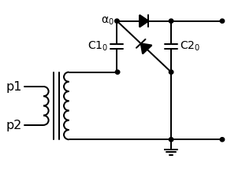

Slide 5
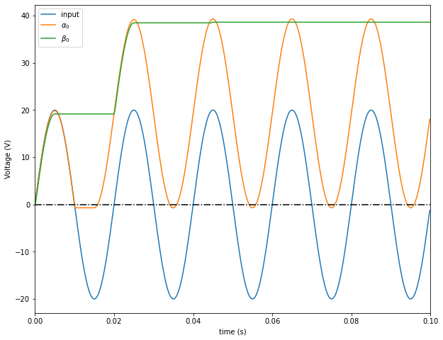

Slide 6
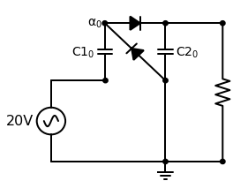

Slide 7


Slide 8
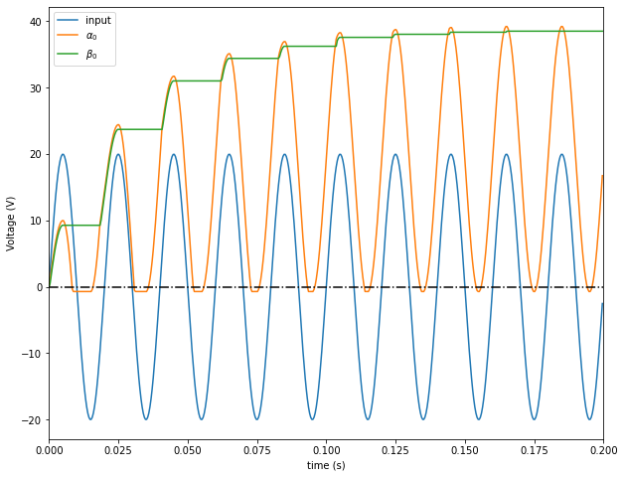

Slide 9
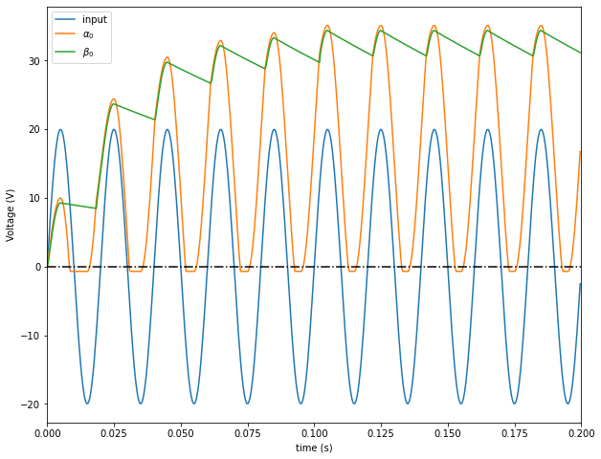

Slide 10
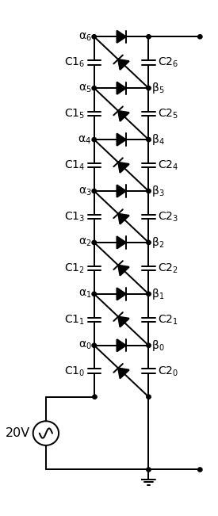

Slide 11
